Slide 1
Distributed control solutions for DER integration
Jakob stoustrup
Professor, PhD
jakob@es.aau.dk

Slide 2
Distributed Control for Grid Applications
Applications of distributed control for grid
Frequency control through optimal load management
Multi-agent based load shedding
Distributed economic dispatch
Economic AGC
Motivation
Growing needs for control and coordination of spatially distributed resources
Communication network for information exchange
Notes:
Consensus + gradient
Leader and follower
Two-layer consensus

Slide 3
Contents
Examples of US Distributed Control Programs
A Distributed Cooperative Power Allocation Method for Campus Buildings
Minimum-time Consensus Based Control and its Grid Applications
Transactive Control & Coordination: A Double-Auction Based Approach to Distributed Control and Decision-making

Slide 4
Examples of US Distributed Control Programs

Slide 5


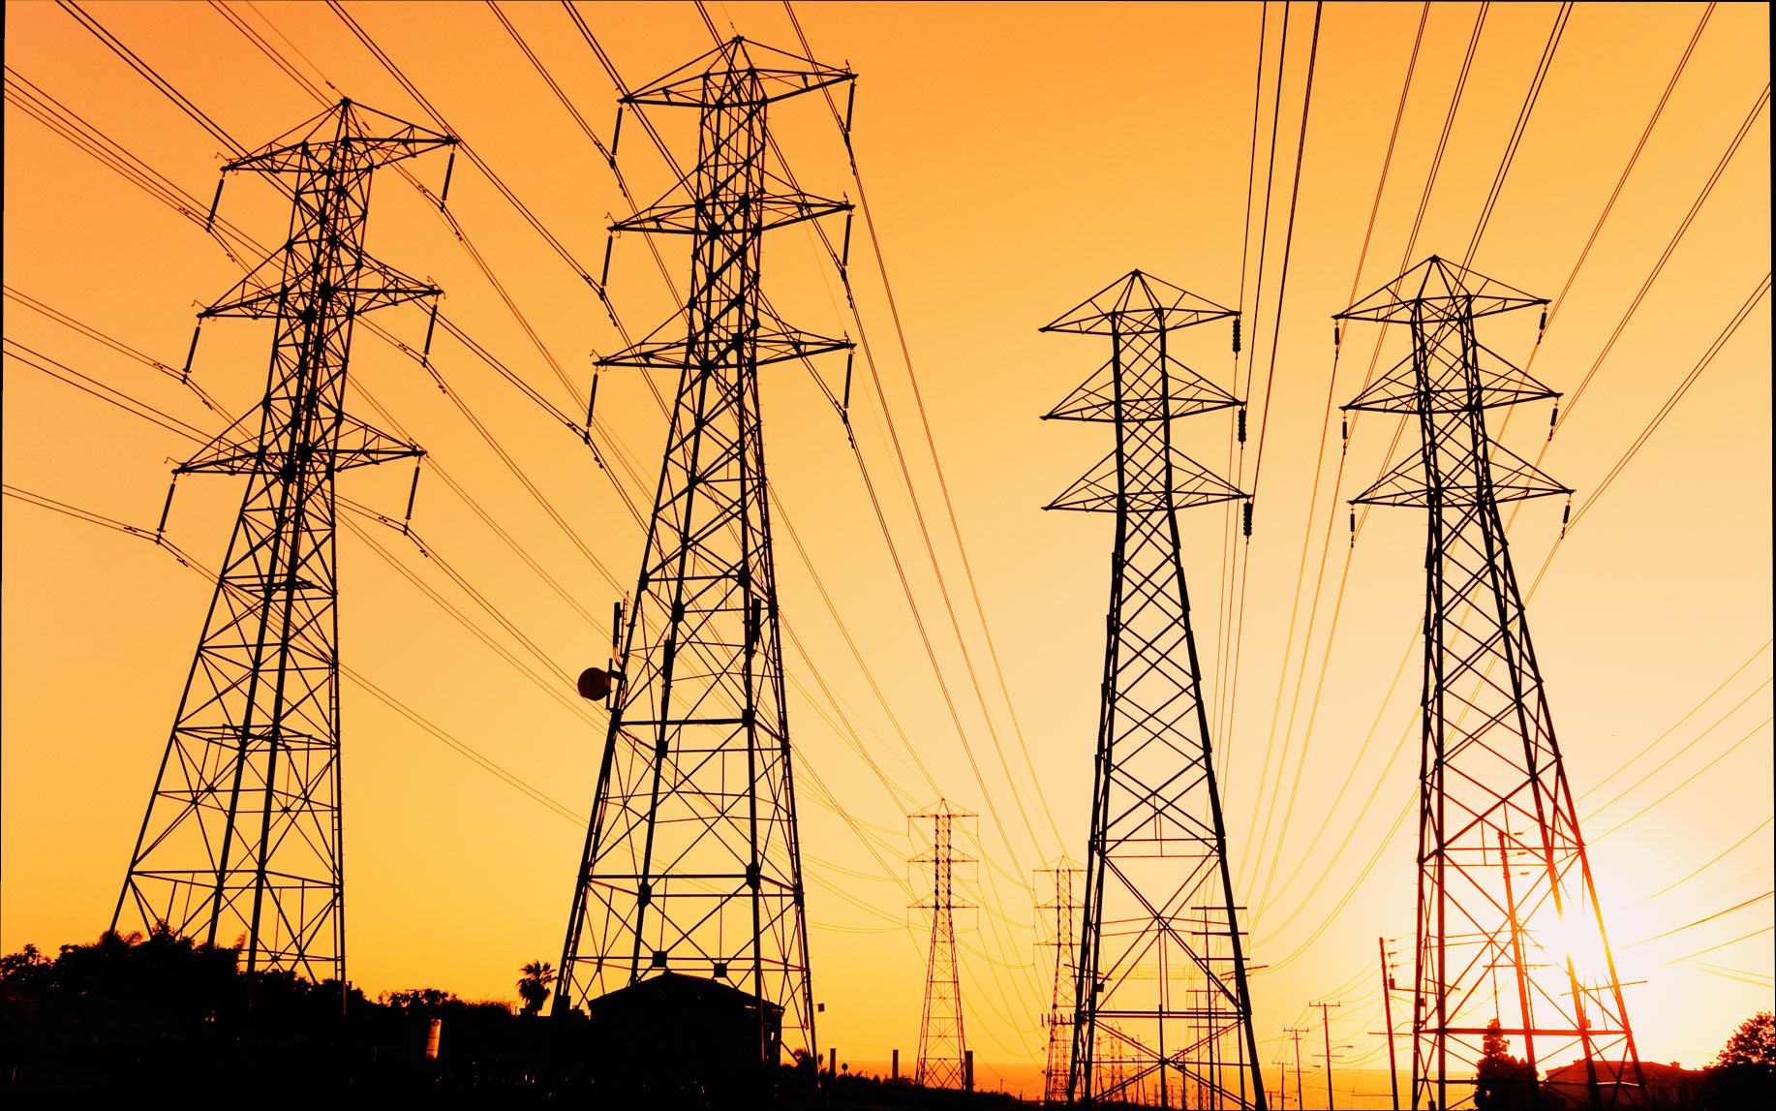
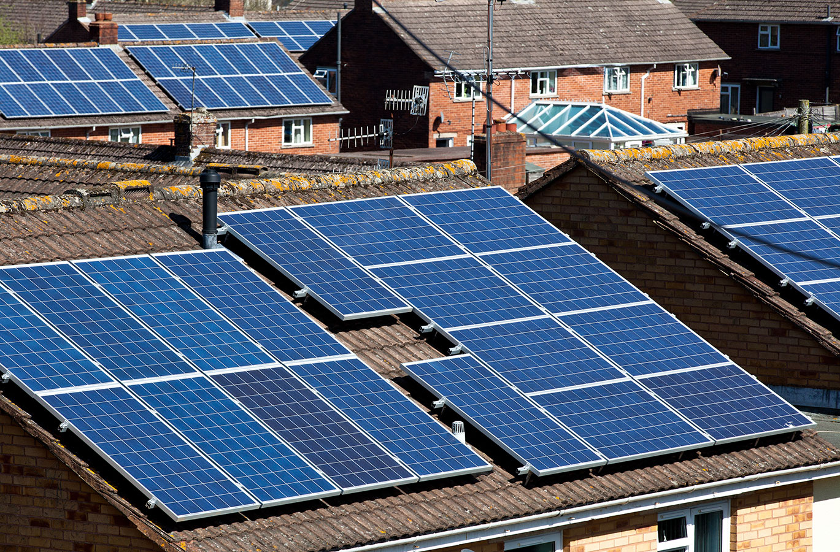



CCSI leads the way to reliability, efficiency, and sustainability
Advanced controls designed to address complexity and variability allow use of all components of our energy infrastructure to their full potential. The result is a more reliable operation, as well as a more efficient and sustainable use of natural resources.
CCSI benefits extend to all infrastructures:
A more reliable electricity system capable of integrating more renewables
Buildings that consume less energy and contribute to stability of the power grid
Safer and more sustainable transportation systems
More cost-effective operation of power grid, buildings, and transportation systems

Slide 6
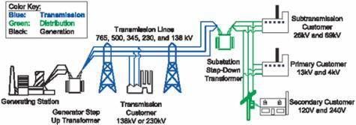
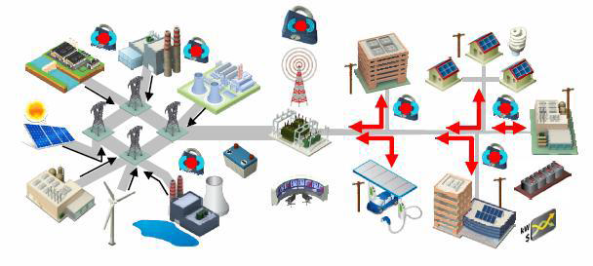
GMLC: Control Theory
Develop new control solutions including topologies, algorithms and deployment strategies for transitioning the power grid to a state where a huge number of distributed energy resources are participating in grid control to enable the grid to operate with lean reserve margins. The theory effort will recognize the need to engage legacy control concepts and systems as we transition to more distributed control.
PoP: FY16/17/18
Budget: $6.5M
Labs: LANL, PNNL, ANL, INL, NREL, SNL, LLNL
Partners: Oncor Electric Delivery, PJM Interconnection LLC, United Technologies Research Center

Slide 7

Virtual Battery-Based Characterization and Control of Flexible Building Loads Using VOLTTRON - Summary
FY16-17-18
$3.6M ($1.25M FY16)
Partners:
The goal of this project is to understand the capacity to use building loads as virtual storage resources and develop control methods to utilize that capacity for transactive buildings that provide grid services.
Understand the capacity of loads such as HVAC, hot water, and refrigeration in commercial and residential buildings to provide virtual storage as a substitute for physical storage on the power grid.
Develop algorithms to optimally control building loads to provide grid services and benefit building owners
Target Market:
The solution is intended for deployment in commercial and residential buildings by energy service providers (e.g. utilities, aggregators) or control system vendors to provide transactive grid services
Building Technologies Office

Slide 8
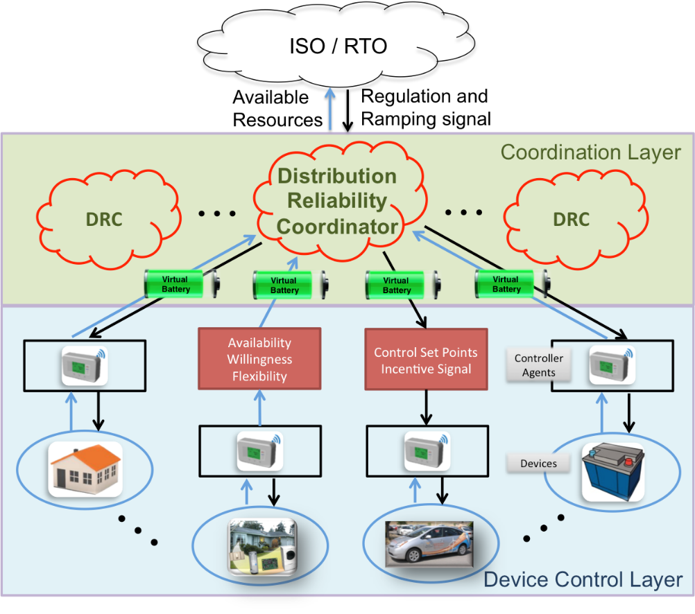
Multi-scale Incentive-Based Control of Distributed Assets ARPA-E NODES
Technology Summary
Available system flexibility estimated using simple virtual battery models
Incentive mechanisms used to economically and efficiently acquire resources without revealing private information
Engaged resources respond autonomously to self-sensed frequency and global control signal received from system
Technology Impact
Improves efficiency and reliability of grid by engaging lowest cost resources to provide ancillary services
Provides level playing field for distributed assets with conventional generation sources
Reduces need for new transmission lines by providing fast-acting location-dependent resources
Proposed Technical Category and Target Metrics
Features | Description
Category | Category 1, 2 and 3
Managed DERs | residential and commercial HVAC systems, smart appliances, electric vehicles, thermal energy storage, PV inverters
FOA Metrics | Initial Response Time <2 seconds; reserve magnitude target >2% for frequency response, >5% for regulation, and >10% for ramping; availability >95%
Test Plan
A co-simulation platform will be designed spanning transmission, distribution, ancillary markets, and communication systems. Hardware-in-the loop will incorporate grid-edge control, DER equipment and systems coupled with virtual components in the simulation to address scalability. Incentive and control signals will be sent to the DER controllers of the HIL test systems. The physical responses of the devices are fed back into the simulation serving as feedback from the hardware to inform on the simulation.
Incentive-based control provides stable response from millions of distributed assets

Slide 9
A Distributed Cooperative Power Allocation Method for Campus Buildings
He Hao, Yannan Sun, Thomas E. Carroll, and Abhishek Somani
Power & Energy Society General Meeting, 2015

Slide 10
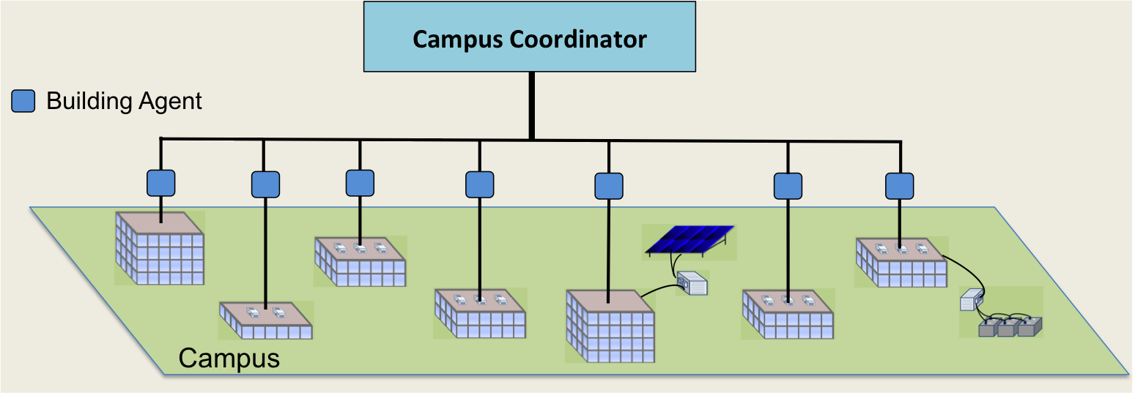




Background
5% peak reduction could reduce the wholesale electricity price by 50%
Peak shaving could save $10–15 billion/year for the U.S. electricity market
Buildings consume about 40% of energy and 75% of electricity in the U.S.
There are 5.6 million commercial buildings, contributing 1/3 of peak load
Peak demand is short, but contributes up to 50% of the overall building bill
Objective: design a distributed and scalable power allocation method for peak load management and other types of demand modulation for a campus with many buildings.

Slide 11
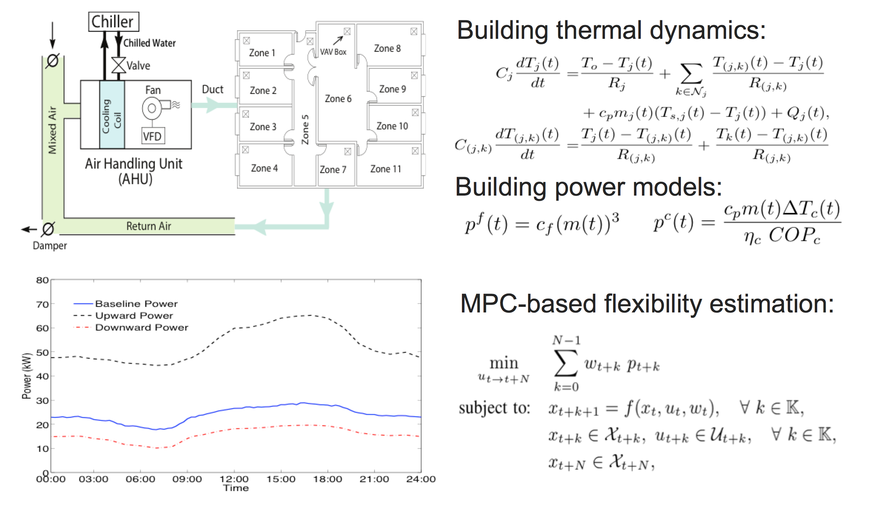
Model Predictive Control approach to characterize building power flexibility

Slide 12
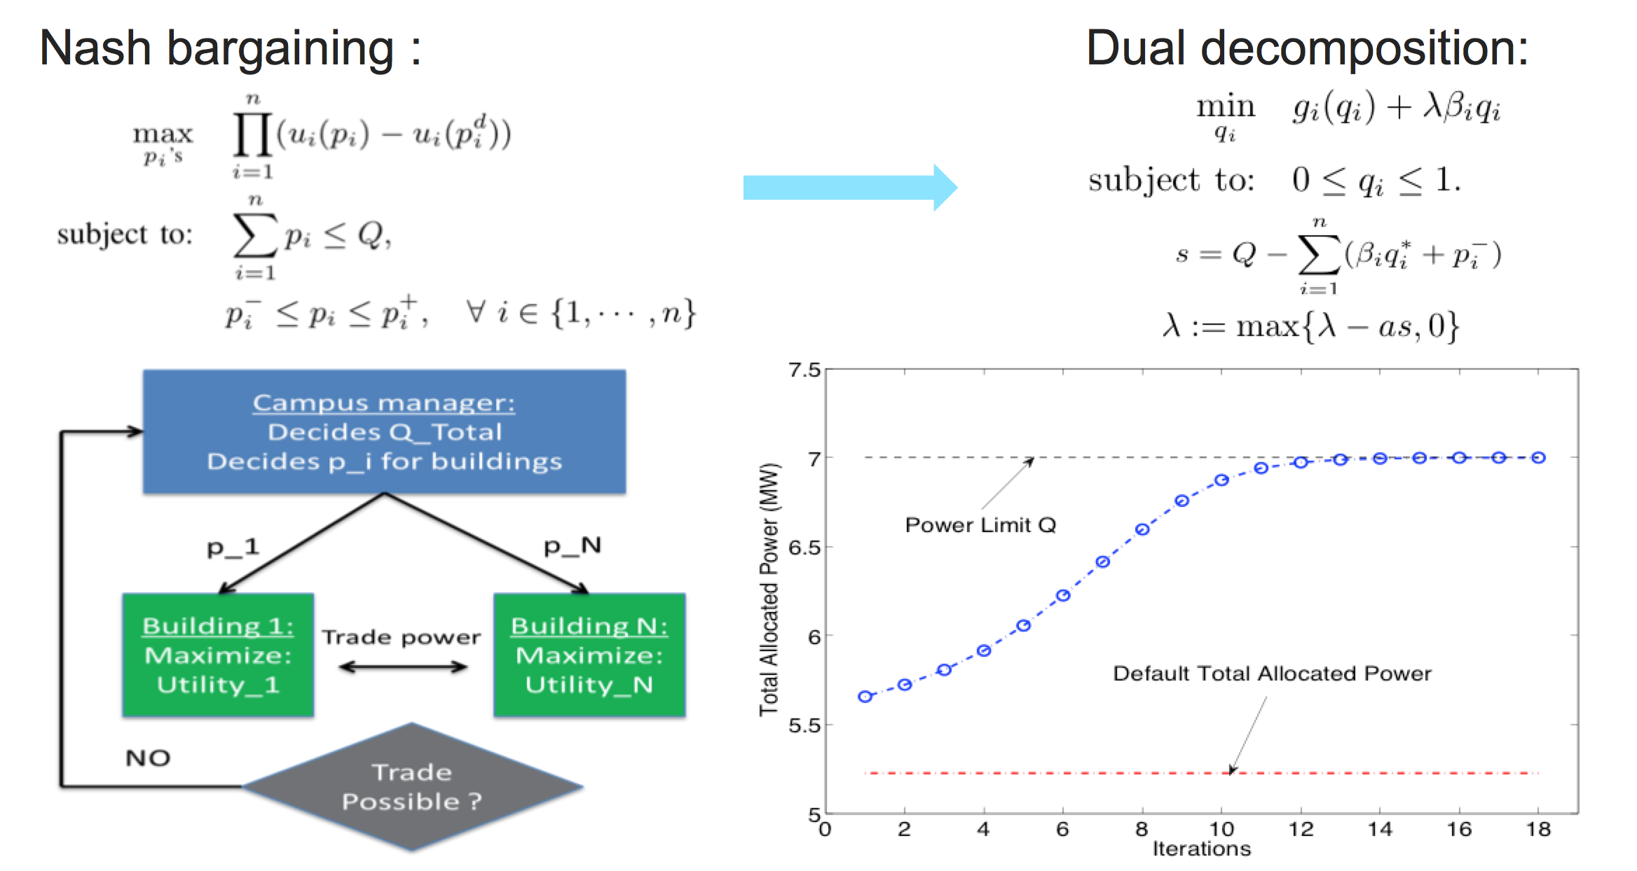
Nash bargaining and dual decomposition are used to solve the negotiation problem
43 buildings

Slide 13
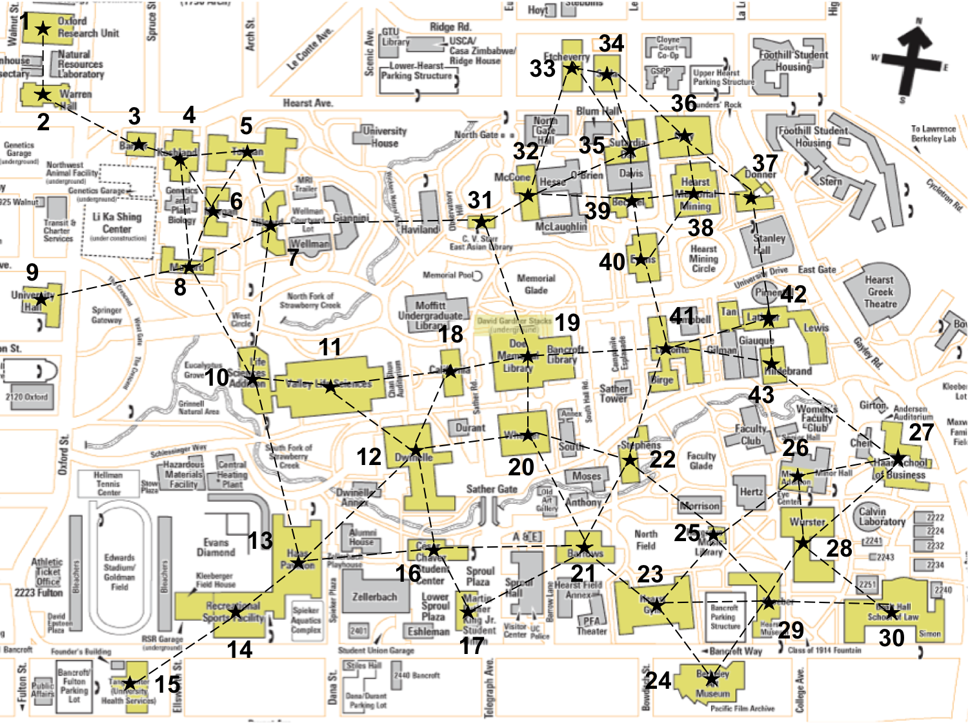
Results
MPC
Model Predictive Control
Nash Bargaining
Dual Decomposition

Slide 14
Distributed Control for Grid Applications

Slide 15
Communication Network Effects – Traffic Congestion
Minimum-time Consensus and its grid applications
T. Yang, D. Wu, Y. Sun and J. Lian, “Minimum-time consensus based approach for problems in a smart grid,” IEEE Transactions on Industrial Electronics, vol. 62, no. 12, pp. 1318-1328, 2016.

Slide 16
Motivation
Classical consensus algorithm converges asymptotically
High communication cost
Time constraints
How to reduce the computational time?

Slide 17
Minimum-time Consensus
Minimum-time consensus
Each agent runs classical consensus and stores local states over a few number of time steps
Computes the consensus value with local states within a minimum number of time steps even before consensus is achieved with a reasonable accuracy
Accelerate the convergence time and alleviate the communication burden
Grid applications: Load shedding and economic dispatch problem

Slide 18
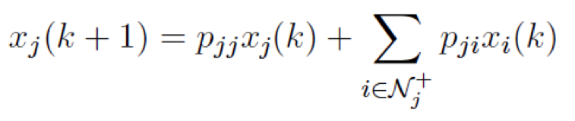
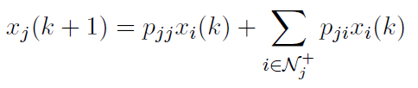
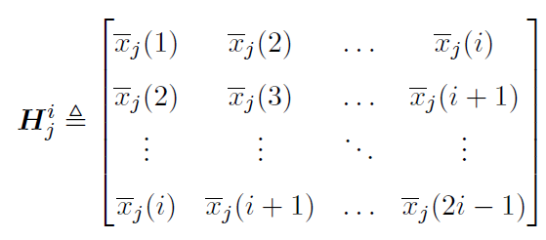
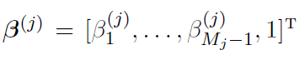
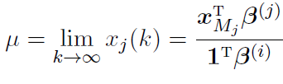
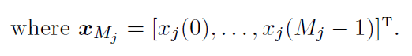
Minimum-time Consensus
Step 1: each agent runs the classical consensus
Step 2: stores the local states, computes the differences, and constructs a square Hankel matrix
Step 3: check the rank, If it loses rank, then computes its normalized kernel
Step 4: computes the final consensus value

Slide 19
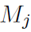
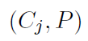
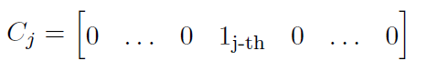
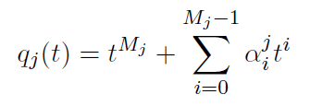
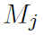
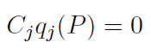
Minimum-time Consensus Backup
Guaranteed to lose rank at time step
is equal to the degree of a minimal polynomial of the matrix pair
where
The minimal polynomial of the matrix pair denoted by
is the monic polynomial of the minimum
degree that satisfies

Slide 20
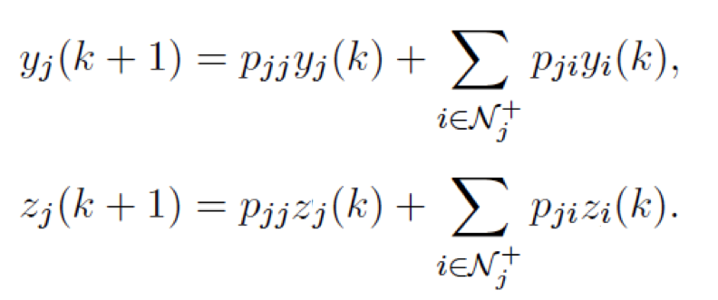
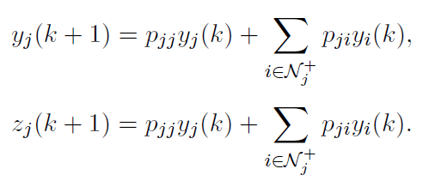
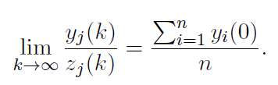
Application to Distributed Load Shedding
Recall the ratio consensus based algorithm
It computes the average asymptotically in the sense that
Apply the minimum-time consensus, each agent computes the average system overload in a minimum number of time steps

Slide 21
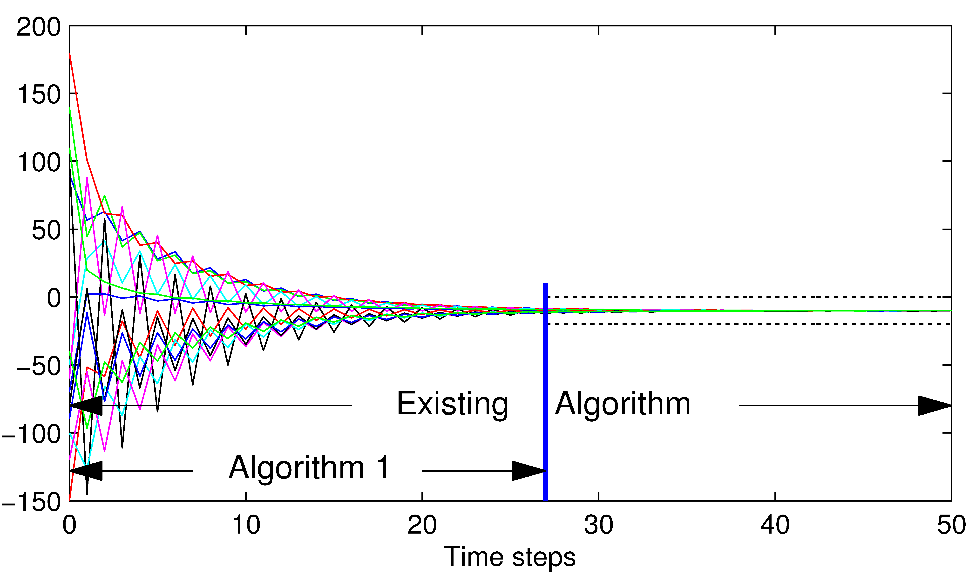
Case studies
IEEE 14-bus system
Communication network is the same as the physical topology
Figure: Discovery process using the existing algorithm vs our algorithm

Slide 22
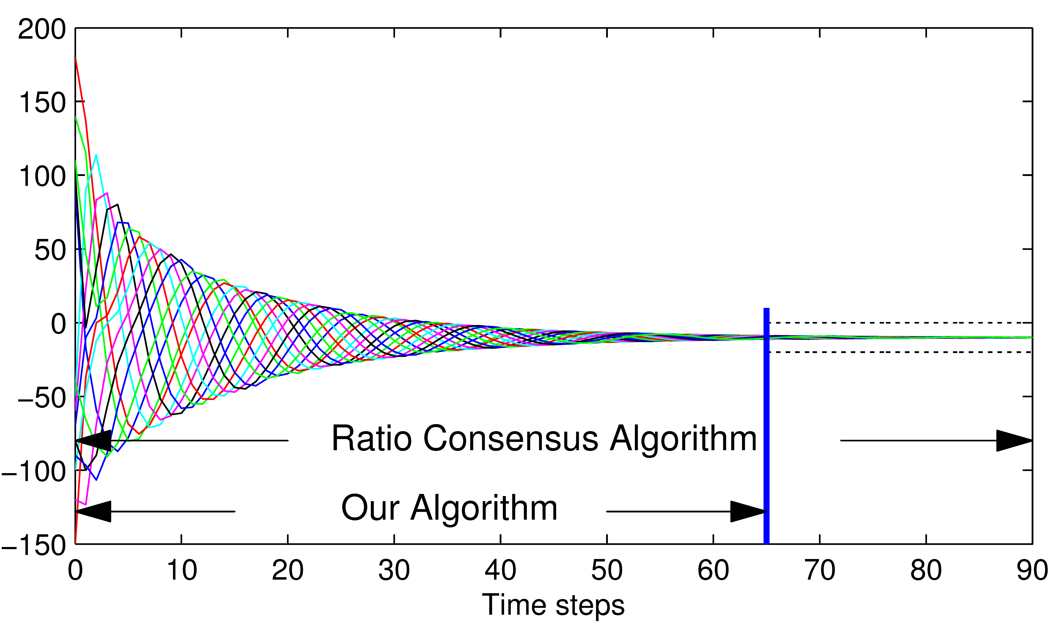
Case studies
Directed Communication network with the edge set
Figure: Discovery process using the existing algorithm vs our algorithm

Slide 23
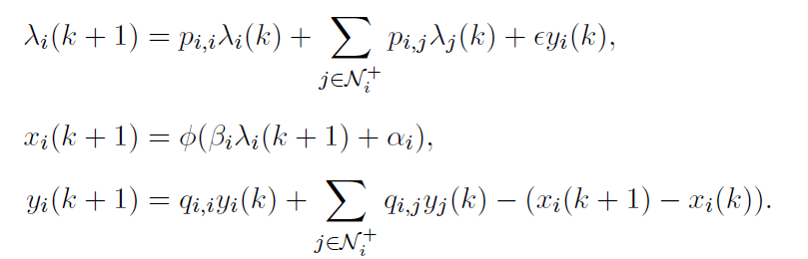
Application to EDP
Recall the distributed algorithm for EDP
It solves the EDP asymptotically
Apply the minimum-time consensus, EDP is solved in a minimum number of time steps

Slide 24
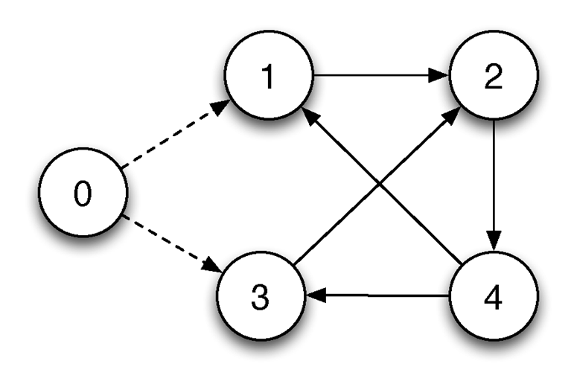
Case studies
Directed communication network
Figure: Communication topology

Slide 25
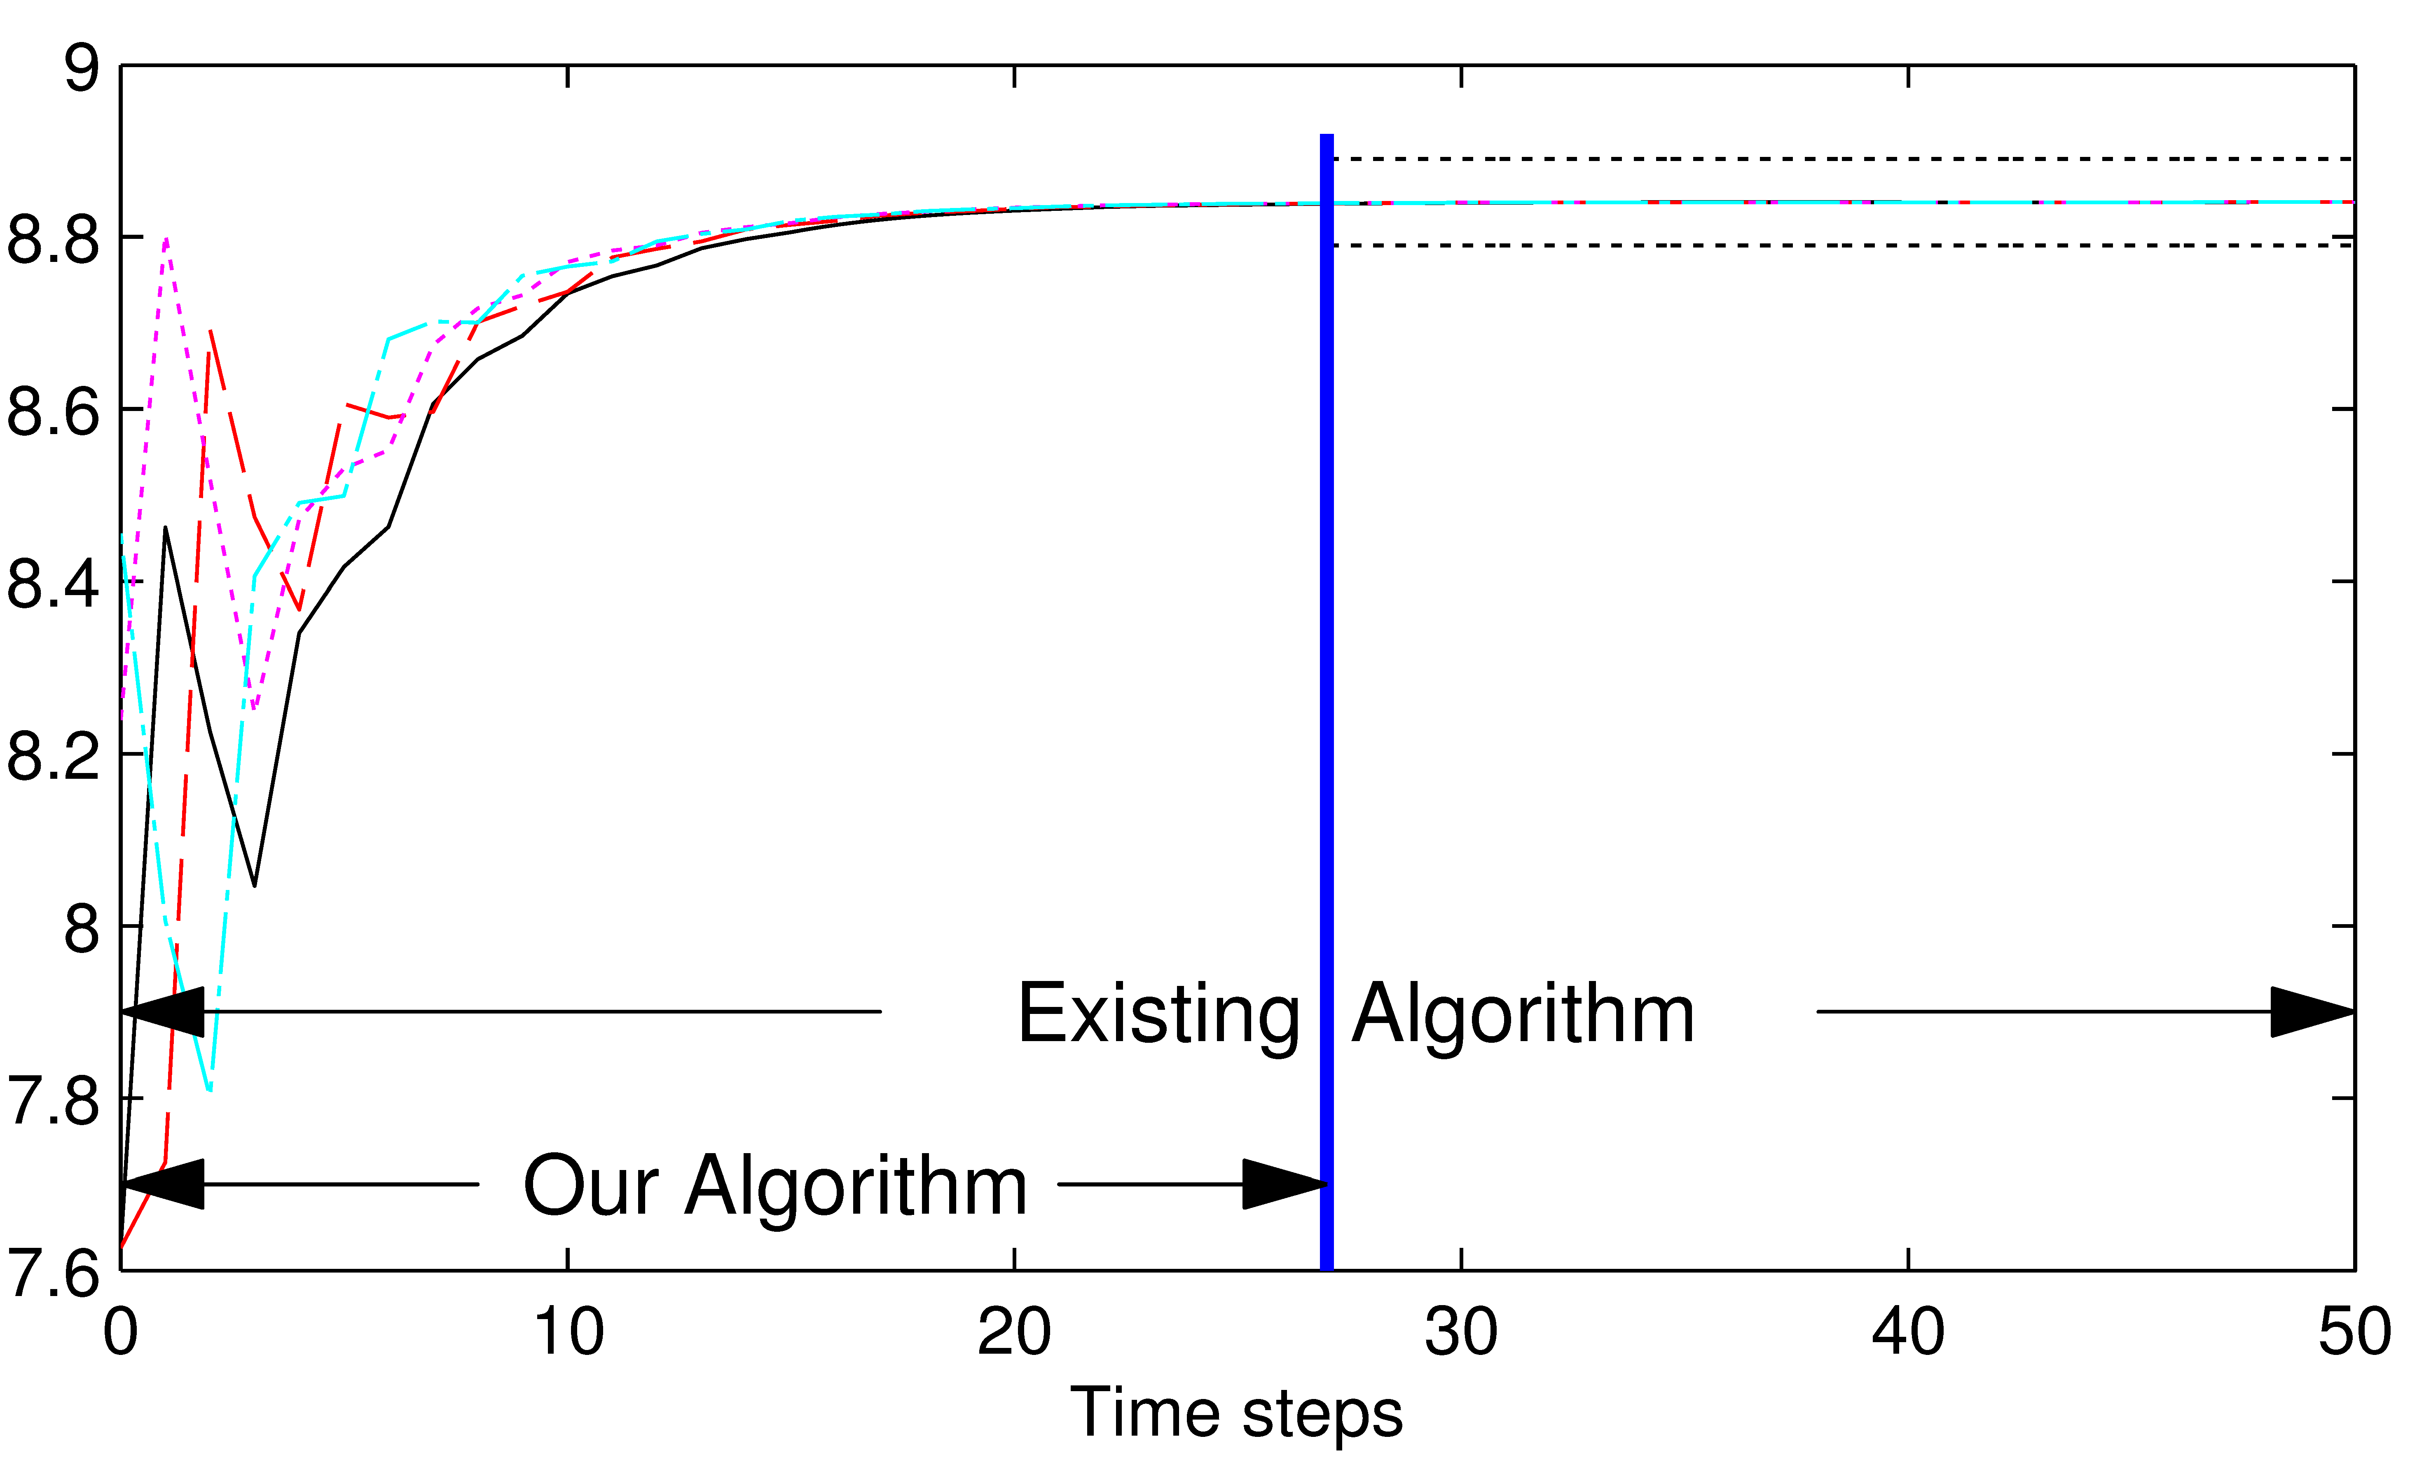
Case studies
Figure: Comparison of Incremental Cost Evolution Process

Slide 26
Communication Network Effects – Directional Communication Links with Delays
Ratio consensus based control and its application to load shedding

Slide 27
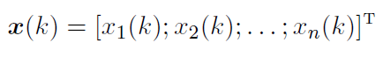
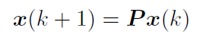
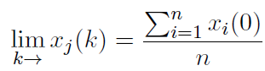
Classical Consensus Algorithm
Examples: sensor network, social opinion dynamics
Classical consensus algorithm
Let
In general, weighted average consensus is achieved
Average consensus is achieved asymptotically, i.e.,
if and only if P is a primitive doubly stochastic matrix, or equivalently, the directed graph is strongly connected and balanced

Slide 28
Ratio Consensus Algorithm
How to compute the average for general directed graphs?
Ratio consensus algorithm
It computes the average asymptotically in the sense that

Slide 29
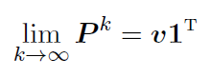
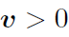
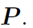
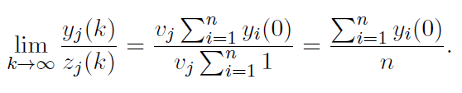
Why Average?
P is column stochastic and primitive, according to the Perron-Frobenius Theorem,
where
is the normalized right eigenvector of

Slide 30
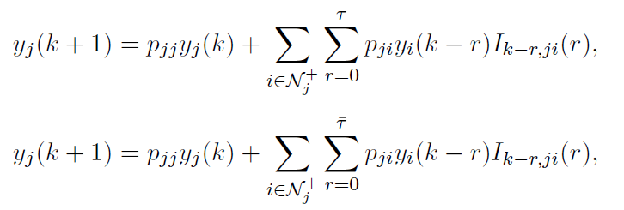
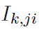
Ratio Consensus Algorithm with Time Delays
Ratio consensus algorithm with bounded communication time delays
where
is an indicator function that captures the bounded delays
Robust to arbitrarily large but bounded communication time delays
Augmented digraph representation method

Slide 31
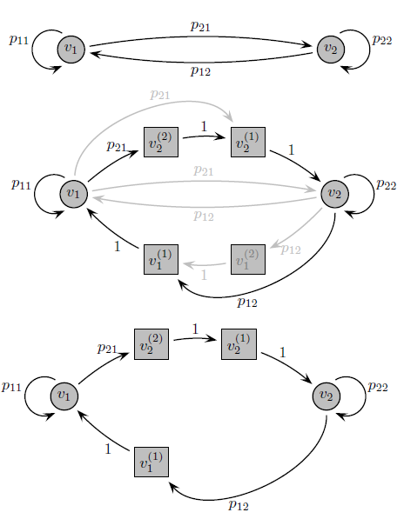
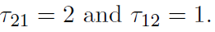
Case Studies
A simple example with two nodes
Top figure – no delay
When the nodes experience bounded time-varying delays, we add “virtual” nodes
Middle figure – delays upper bounded by 2 time steps. Communication either directly or through the “virtual” nodes
Bottom figure – a particular scenario where

Slide 32
Application to Load Shedding
When generation is insufficient to support all loads, effective load shedding needs to be deployed
Distributed algorithm for discovering the average system overload
Undirected communication networks without communication time delays
We propose a ratio consensus based distributed algorithm to discover the average system overload over directed communication networks even with arbitrarily large time varying delays

Slide 33
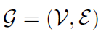
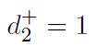
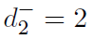
Case Studies
IEEE 14-bus system
Communication network is independent of the physical topology and is modeled as a directed graph
with the node set V={1,2,….,14} and the edge set
The directed graph is strongly connected
However, not balanced since for node 2, the in-degree is
which is not equal to its out-degree

Slide 34
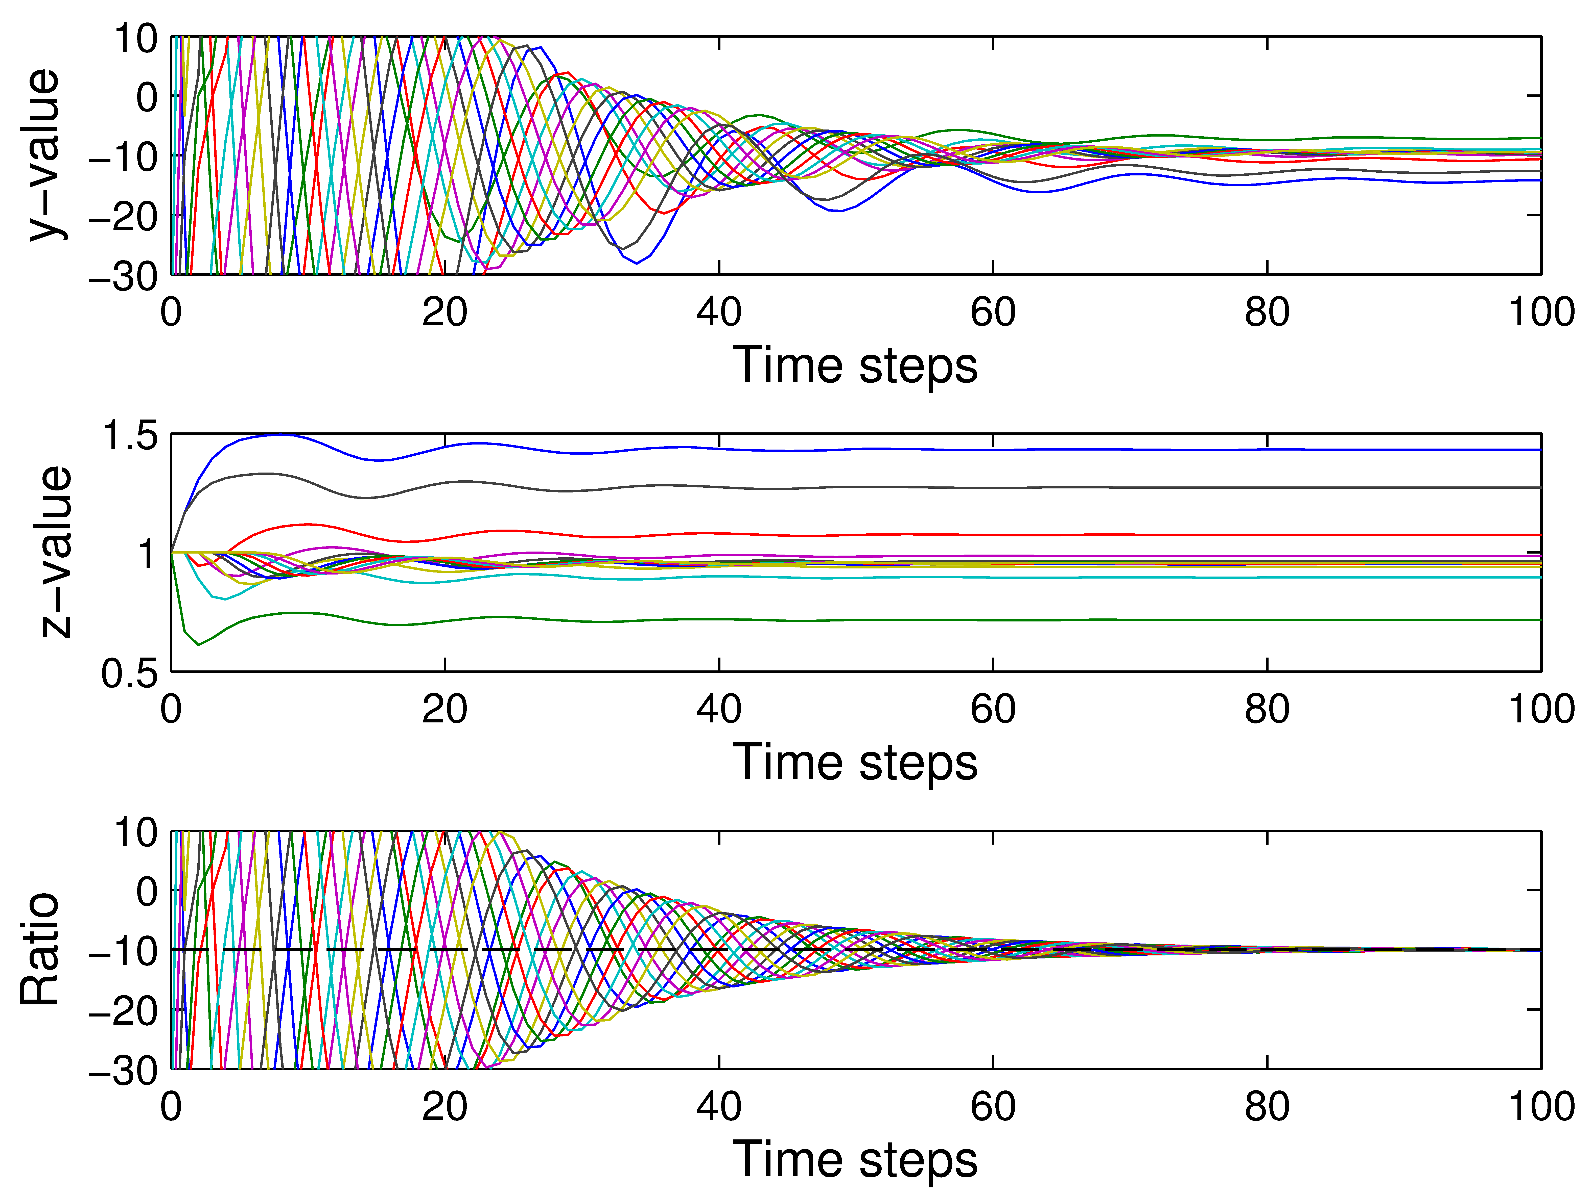
Case Studies
Figure: Perfect communication

Slide 35
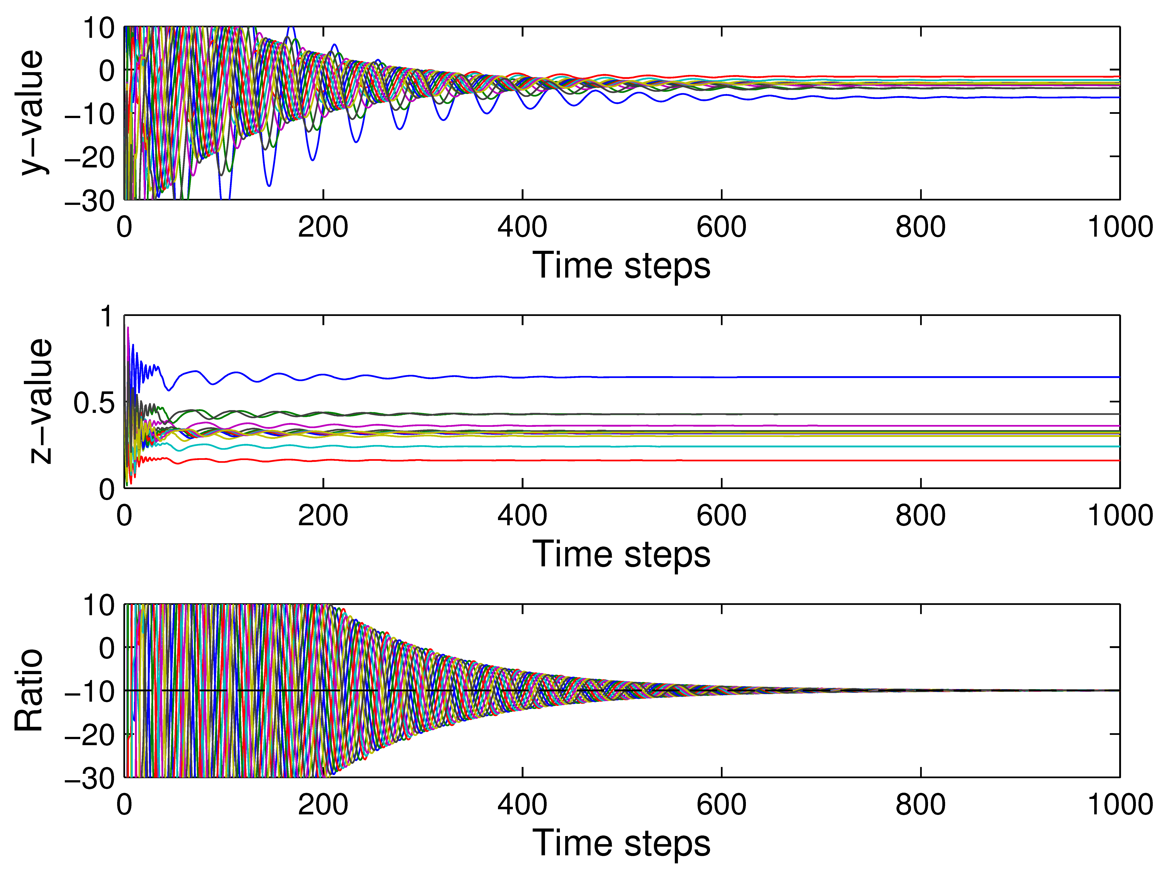
Case Studies
Figure: Uniform constant delay equal to 3

Slide 36
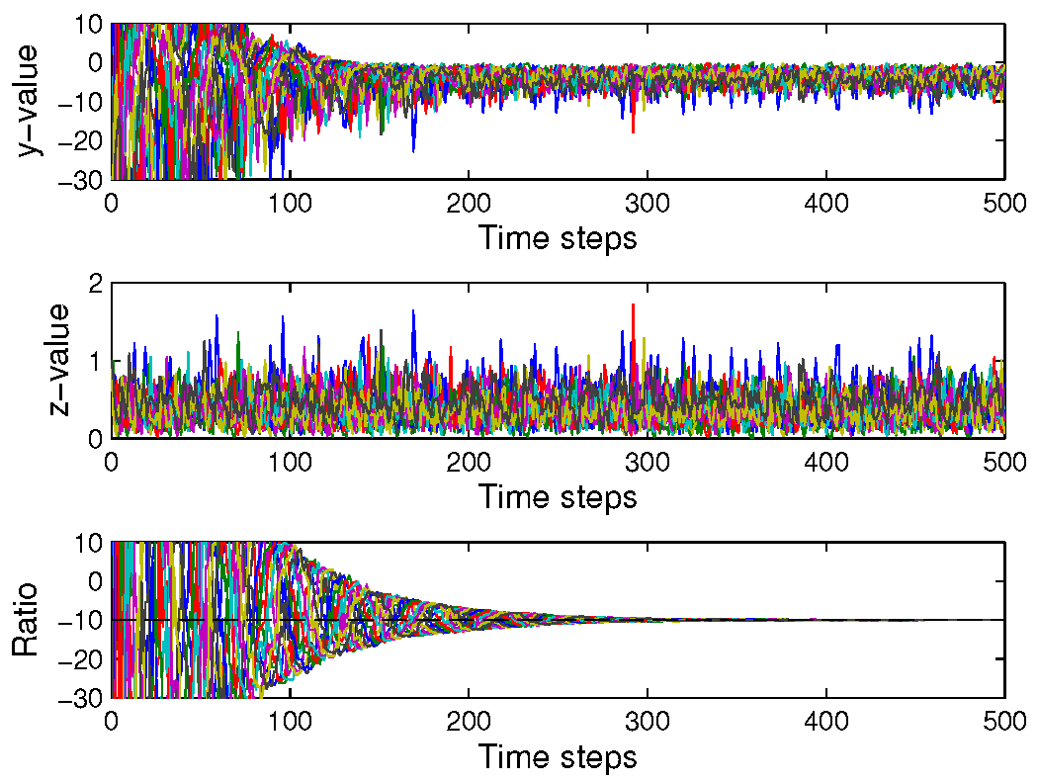
Case Studies
For time varying bounded 5 steps, both y and z do not converge, however, their ratio y/z converges to the average system overload.
Figure: Time-varying delays

Slide 37
Impacts of Communication Networks on Distributed Controls
Objective
Investigate the network effects on existing distributed control algorithms for grid applications
Time delays
Packet dropouts
Directional communication links
Develop distributed control algorithms to better accommodate various communication network effects

Slide 38
Communication Network Effects – Time Delays
Impacts of communication time delays on distributed algorithms for EDP
T. Yang, D. Wu, Y, Sun and J. Lian, “Impacts of time delays on distributed algorithms for economic dispatch,” in Proc. IEEE Power Energy Society General Meeting, Denver, CO, July 26-30, 2015.

Slide 39
Distributed Algorithms for EDP
Economic Dispatch Problem (EDP)
Centralized vs. distributed
Several consensus-based distributed algorithms have been proposed.
In these algorithms, information is exchanged through a perfect communication network.
However, communication time delays are ubiquitous in network. We aim to investigate impacts of delays on a distributed algorithm.

Slide 40
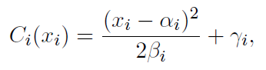
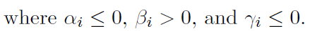
Consensus-based Distributed Algorithm w/o Time Delays
Quadratic cost function
For strongly connected communication networks

Slide 41
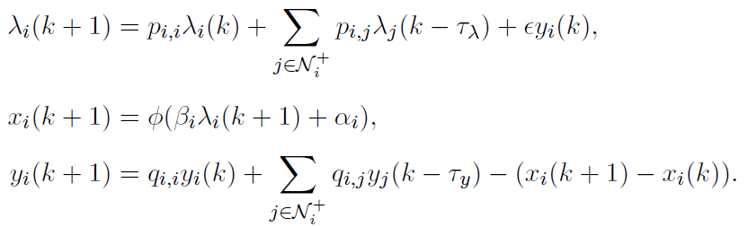
Impacts of Communication Time Delays
Distributed algorithm with communication time delays

Slide 42
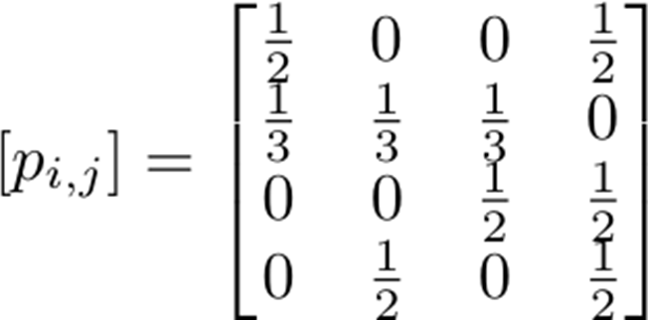

Case Studies
Distributed algorithm with communication time delays
row stochastic
Figure: Communication topology
column stochastic

Slide 43


Case Studies
Figure: Converge to the centralized optimal value

Slide 44


Case Studies
Figure: Converge to the centralized optimal value yet with a slower convergence rate

Slide 45


Case Studies
Figure: Diverge, power balance is not achieved

Slide 46


Case Studies
Figure: Converge to the incorrect value, power balance is not achieved

Slide 47


Case Studies
Figure: Converge to the incorrect value, more oscillation during the transient

Slide 48
Conclusion and Future Work
Communication time delays have negative impacts
Slower convergence rate
Divergence
Converge to incorrect values
Propose distributed algorithm for EDP to accommodate time delay impacts

Slide 49
Conclusion and Future Work
A ratio consensus based distributed algorithm for load shedding over directed communication networks even with arbitrarily large time varying delays
Consider impacts of packet dropouts of the proposed algorithm

Slide 50
Transactive Control & Coordination: A Double-Auction Based Approach to Distributed Control and Decision-making

Slide 51
Transactive Cooling Thermostat Generates Demand Bid based on Customer Settings Price (Cooling Example) –
Thermostat (Today)
User‘s comfort/savings setting implies limits around normal setpoint (T_{desired}), temp. elasticity (k)
Current temperature used to generate bid price at which AC will “run”
AMI history can be used to estimate bid quantity (AC power)
Market sorts bids & quantities into demand curve, clears market returns clearing price
Thermostat adjusts setpoint to reflect clearing price & temperature elasticity
k
k
P_{clear}
1
P_{bid}
Price*
More
Comfort
More Savings
P_{avg}
Translates to: k, T_{max}, T_{min}
T_{min}
T_{desired}
T_{current}
T_{set}
T_{max}
Indoor Temperature
Notes:
AMI = advanced metering infrastructure

Slide 52




RTP Double Auction Market – Uncongested
Unresponsive
Loads
Responsive
Loads
Market clears every T_{S}= 5min (to ~match AC load cycle)
When uncongested:
Quantity (Q_{clear}) varies with demand curve
Price (P_{clear}) is constant, equal to Base RTP
Demand Curve: sorted (P, Q) bids from trans-active customers
Retail RTP based on wholesale real-time LMP (Base RTP)
Market clears at intersection of supply & demand curves
Feeder Supply Curve
P, Price ($/MWh)
P_{clear} =
P_{base}
Varies every T_{S} = 5
min
Feeder Capacity
Q_{min}
Q_{clear}
Q_{max}
Q, Load (MW)
Notes:
RTP = real time pricing

Slide 53
RTP Double Auction Market – Congested
Unresponsive
Loads
Responsive
Loads
When constrained:
Quantity (Q_{clear}) is constant at rated feeder capacity
Price (P_{clear}) varies to keep load at rated capacity
Demand Curve: sorted (P, Q) bids from trans-active customers
Retail RTP based on wholesale real-time LMP (Base RTP)
Market clears at intersection of supply & demand curves
Feeder Supply Curve
P, Price ($/MWh)
P_{clear}
P_{base}
Rated Feeder Capacity
Q_{min}
Q_{clear}
Q_{max}
Q, Load (MW)

Slide 54
What about the Congestion Surplus?
customers providing capacity
Congestion surplus is extra revenue collected from customers during constrained conditions (i.e. P_{clear} > P_{base})
Each customer’s surplus returned as billing rebate to maintain revenue neutrality
A PTR-like* incentive is also offered during congestion, based on customer’s bid history
congestion rebate
congestion incentive
Feeder Supply Curve
P_{clear}
P, Price ($/MWh)
Congestion Surplus_{t}
P_{bid}
P_{base}
* peak time rebate
Q_{total}
Q_{bid}
Feeder Capacity
Q_{clear}
Q, Load (MW)

Slide 55
Hierarchical Network of Transactive Nodes Parallels the Grid Infrastructure
Node: point in the grid where flow of power needs to be managed
Node Functionality:
“Contract” for power it needs from the nodes supplying it
“Offer” power to the nodes it supplies
Resolve price (or cost) & quantity through a price discovery process
market clearing, for example
Implement internal price- responsive controls

Slide 56

Olympic Peninsula Demonstration
IBM
Invensys
Market
ancillary services
$
distribution congestion
transmission congestion
MW
wholesale cost
0 6 12 18 24
Clallam County
PUD Water
Supply District
0.2 MW DR
Internet broadband
communications
Clallam PUD & Port Angeles
n = 112, 0.5 MW DR
Sequim Marine Sciences Lab
0.3 MW DR
0.5 MW DG
Johnson
Controls
Johnson Controls

Slide 57

Pacific Northwest Demonstration Project
What:
$178M, ARRA-funded, 5-year demonstration
60,000 metered customers in 5 states
Why:
Quantify costs and benefits
Develop communications protocol
Develop standards
Facilitate integration of wind and other renewables
Who:
Led by Battelle and partners including BPA, 11 utilities, 2 universities, and 5 vendors
Notes:
1 = PGE | 2 = Bonneville Power Administration | 3 = Peninsula Light Co. | 4 = Seattle City Light/University of Washington
5 = City of Ellensburg | 6 = Battelle | 7 = Benton PUD | 8 = Milton Freewater | 9 = Avista | 10 = Flathead Electric
11 = Northwestern Energy | 12 = Idaho Falls Power | 13 = Lower Valley Energy
57

Slide 58
Thank you for your attention.
Any questions?

